Slide 2
Nuix’s Java API

Slide 3
Today’s Program
Nuix’s Java API
Nuix’s Technology Stack
Right Tool : Right Job
Important Info for the Java Developer
Demo: Teaching Nuix to Feel Feelings with BasisTech & Rosette
Walkthrough
Sustainable Development Practices

Slide 4
Nuix’s Technology Stack
Nearly 2 Decades of Innovation and Refinement
Built on Java
Java API – Native Integration & automation
REST API – Distributed Integration & automation
Powerful Indices
Derby:Lucene
Elasticsearch
Built in orchestration

Slide 5
Right Tool : Right Job
Why Java? Or any Native API?
Benefits | Considerations
Mature & feature rich | Not client:server by nature
IDE integration | Bit of a learning curve
Easy to debug | Distributed / REST is popular
Supports unit & regression testing | Oracle will charge for Java 9
Sustainable | Dependency management
Great for middleware logic | Frameworks abound

Slide 6
Important Info for the Java Developer
Some Essential Data
Nuix is built on the Java stack
Performance is a function of Memory, CPU (workers) and I/O
Mind your –Xms and –Xmx
Nuix currently provides a ZIP w/ all JAR files
Nuix is evolving:
Dependency Management (Maven/Docker)
Distribution of artifacts
Developer tools and resources

Slide 7
Important Info for the Java Developer
Some Essential Data – part deux
IDE integration is a major benefit:
Eclipse
IntelliJ
NetBeans
Useful Tools
Intelli-sense, refactoring, source control integration, Maven integration, etc…
Initial Setup vs Long-term Sustainable Development

Slide 8
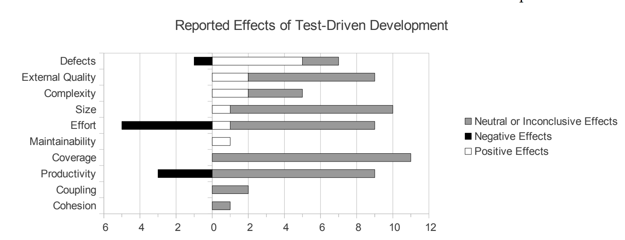
Important Info for the Java Developer
A Note on Test Driven Development
A Discipline
Clear benefits but encounters resistance to practical implementation
Effects of Test-Driven Development: A Comparative Analysis of Empirical Studies by Simo Mäkinen and Jürgen Münch, University of Helsinki, Department of Computer Science © Springer 2014, 6th International Conference Software Quality Days (SWQD 2014), Vienna, Austria, January 14-16, 2014.

Slide 9
Demo: A Java Integration
Teaching Nuix to Feel Feelings w/ Rosette
Process Items with Text
Submit the text for sentiment analysis via WSS
Apply the resulting analysis as item properties
Extract people, places and things from text for sentiment analysis
Add those extracted entities and their sentiment analysis as children

Slide 10
Practical Demonstration

Slide 11
Recap
Let’s Review
Made use of Eclipse’s suite of developer tools
Extracted and submitted Text to a 3rd party application
Utilized a Java implementation of Worker Side Scripting (WSS)
Enriched found items
Created logical data structures per my logic
Iterated development, upgrades and changes

Slide 12
Let’s Walk Through It

Slide 13
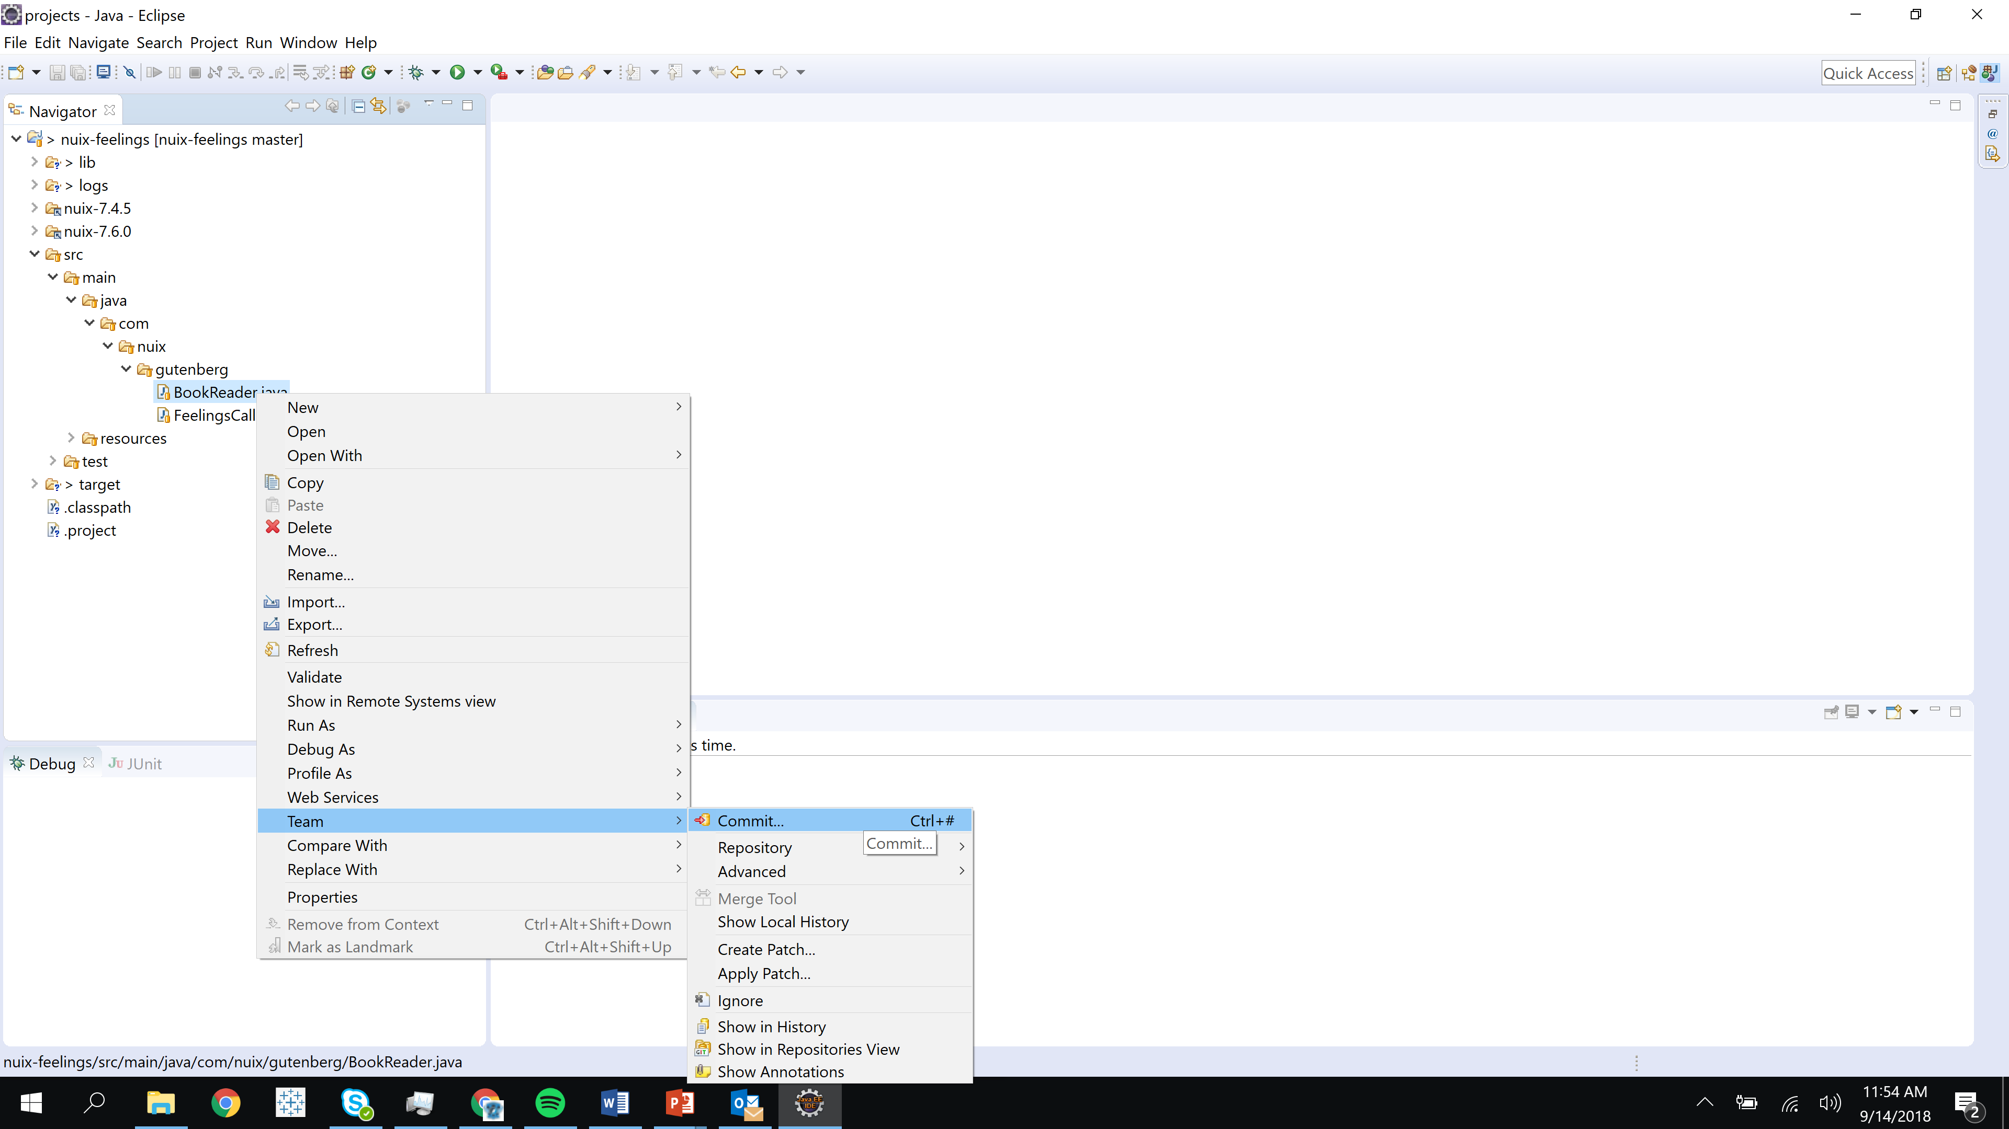
Developer Tools
Enable Developers to Do More Faster
Source Control
Intelli-sense
Debugging
Setting Break Points
Stepping Through Code
Examining the Stack
Unit & Regression Suite
Etc…

Slide 14
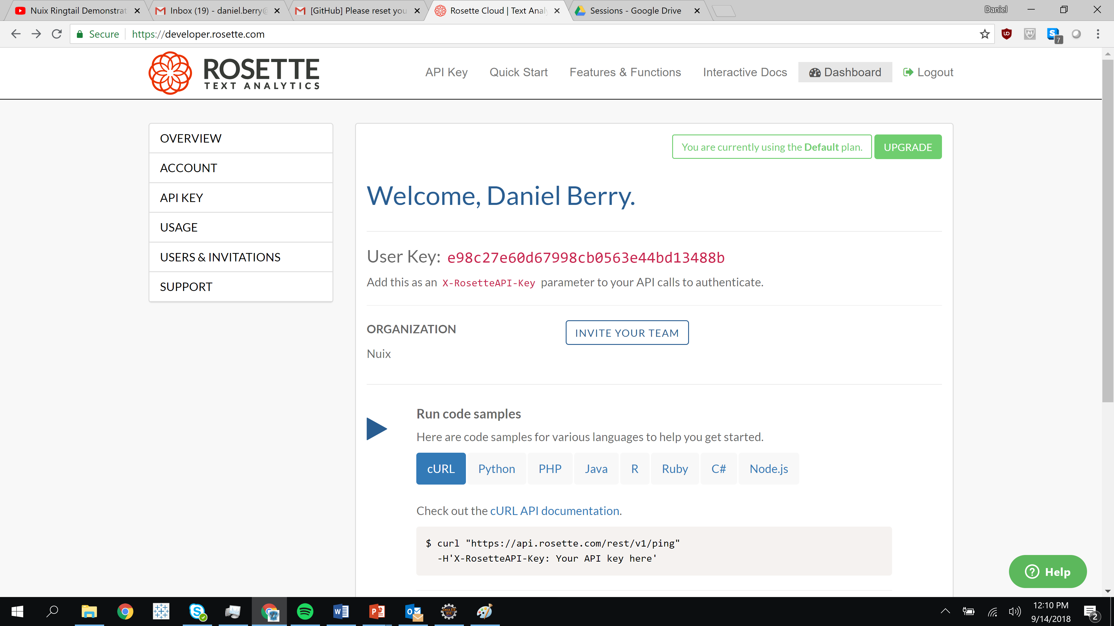
3rd Party Integrations
Right tool for the right job!
BasisTech Rosette is a 3rd party application
Provides an engine for contextual and sentiment analysis
No agreements or partnerships w/ Nuix
Free API key provides 1000 calls/day 10,000/month
Service is via a RESTful API with Python, PHP, Java, R, Ruby, C# and Node.js clients

Slide 15
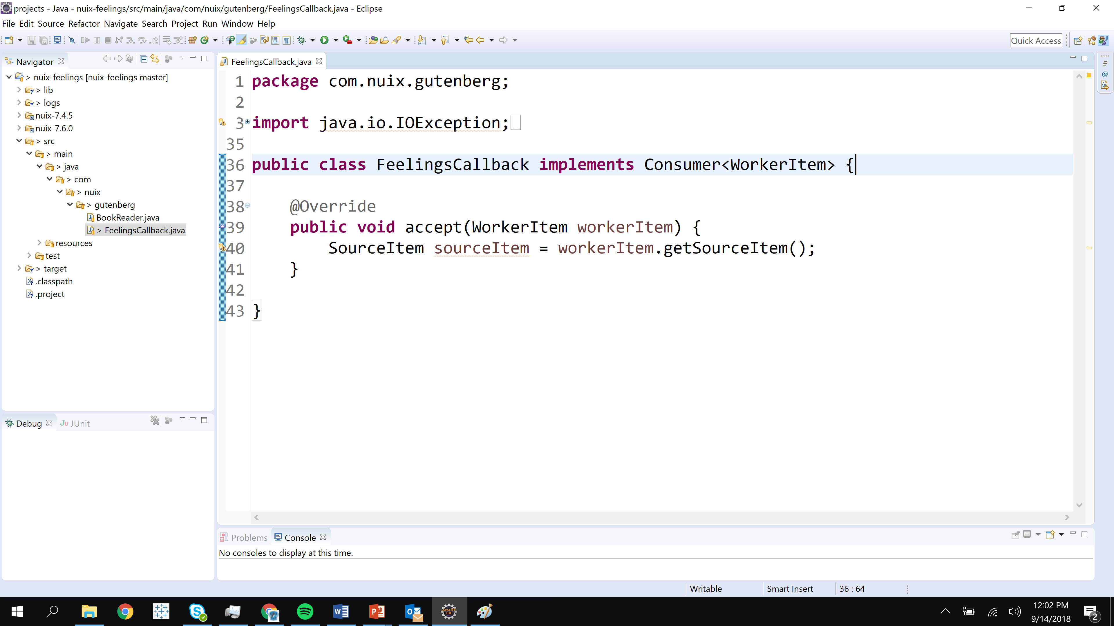
Nuix Worker Side Scripting
Scalpel or Sledgehammer?
A powerful technique
Full control of data traversal
Leverages Nuix’s proprietary orchestration

Slide 16
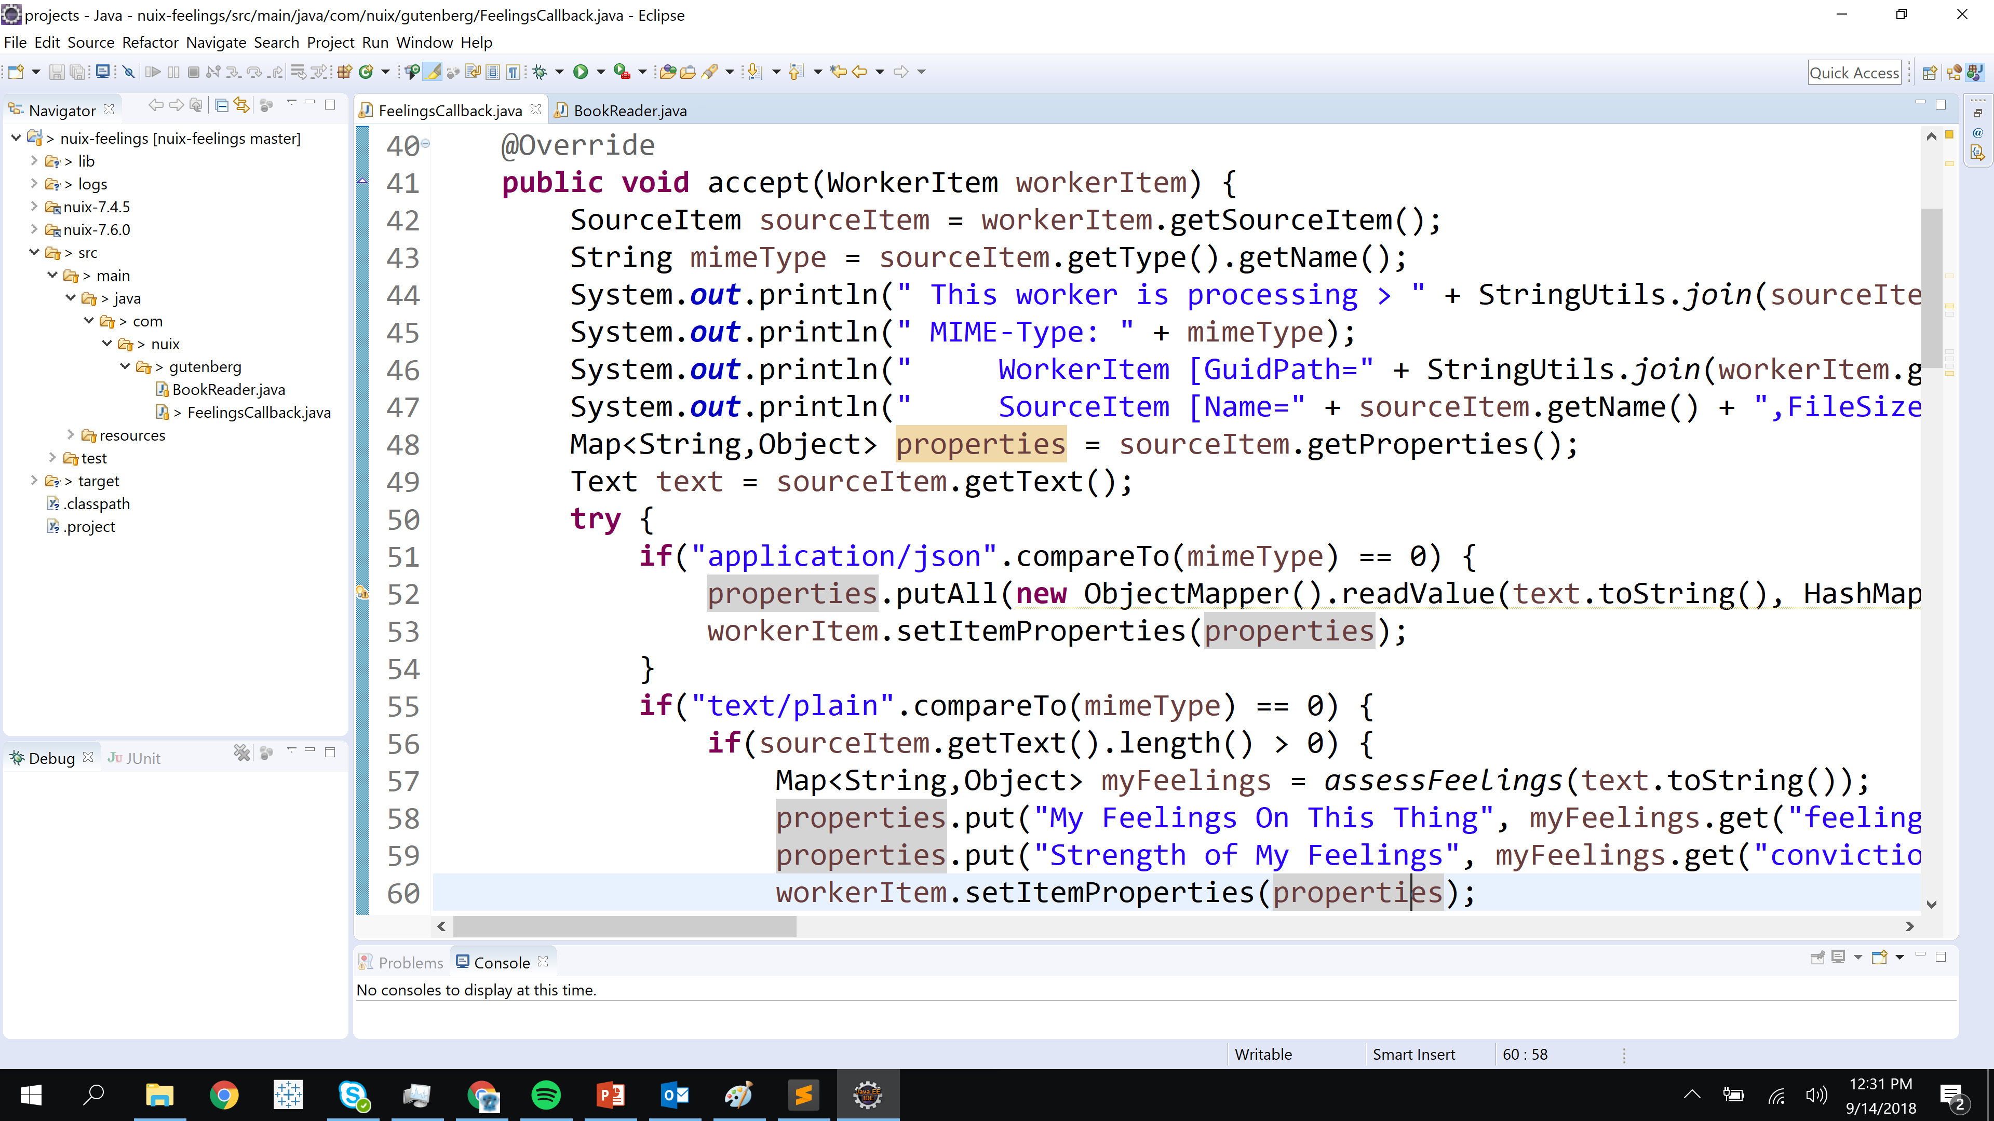
Data Enrichment
Nuix SMASH!
Nuix data enrichment capabilities are powerful
Workers can do more than normalization
Enriching item fields during ingest can accelerate your workflow
Strongly typed fields better enable downstream searching and reporting

Slide 17
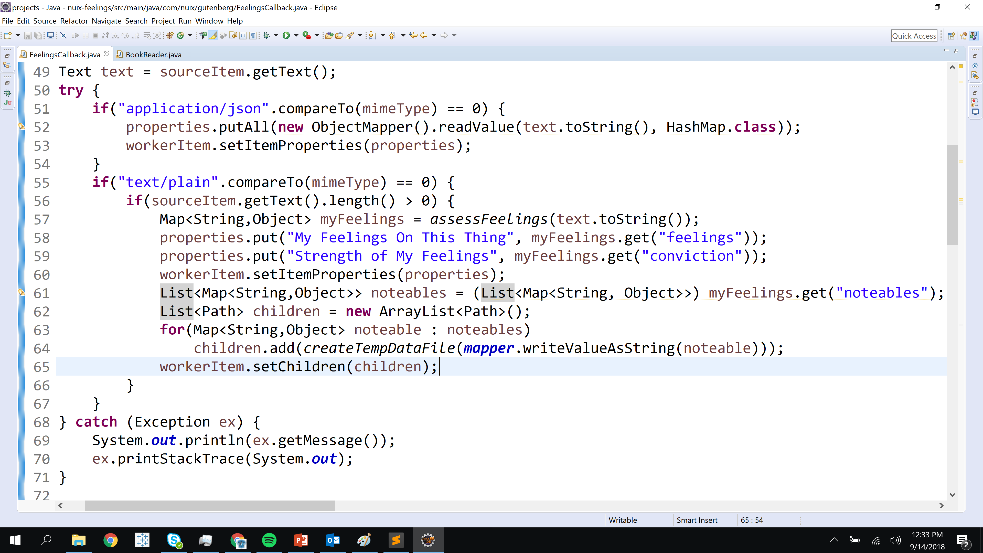
Customized Data Structures
Don’t be limited
Default processing captures items as is
Worker Side Scripting allows you to create:
Logic data structures
Hierarchies
Supporting data points
Associated renditions or translations

Slide 18
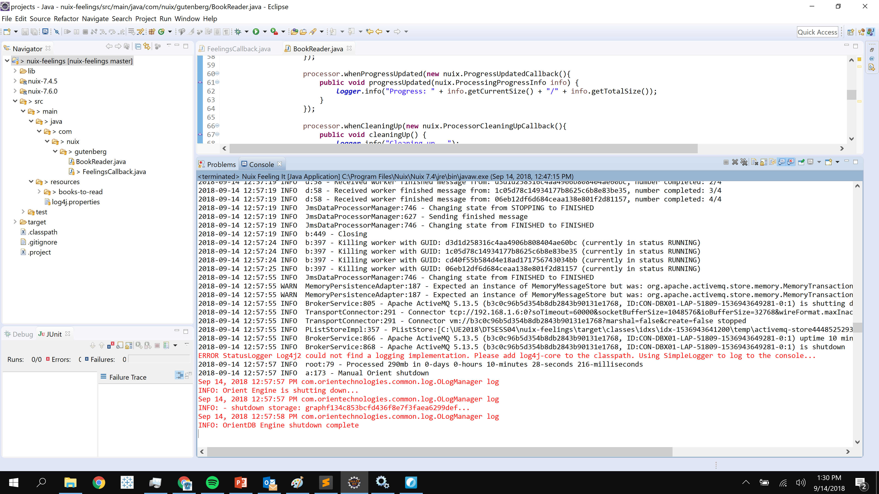
Iterative Development Enablement
And Log4j…
Developers can run code right within the IDE
Iterations are quick
Tasks are completed faster with less bugs
Logging facilities are a big enablement

Slide 19
To Summarize
What do I hope you walk away with?
A better understanding of how the Nuix API can fit into your architecture
The impact that developer tools and IDEs can have on your turnaround
The benefits of Test Driven Development
Some entertainment from the demo of how to make Nuix feel feelings
Some useful mechanics / sample code

Slide 20
Discussion
Can native APIs benefit your work?
?

